Slide 1



SCHEDULING ARCHITECTURE
Weighted Visit
Assignment
How the system decides who goes on each family visit
Three layers, five weighted terms, one auditable number
Prepared for the lab team and PI • August 2026
Notes:
Goal of this deck: make the visit assignment rule explicit enough that any coordinator can reproduce it by hand, and any pick can be explained to the PI or to a family.

Slide 2



WHY A WRITTEN RULE
Every assignment answers three questions
1
2
3
Who can go?
Who fits best?
Who decides?
Some people are ruled out before anyone compares them. An open calendar slot, the right certification, no conflict with the family, and a way to get there.
Fair rotation, family history, drive time, and current workload all matter at once. A number lets us weigh them together instead of one at a time.
Close calls and sensitive family situations stop the automatic pick and go to the coordinator or the PI.
The three questions map onto three layers. A layer is never skipped, and a later layer never undoes an earlier one.
The Early Social Development Lab at UofSC
2
Notes:
Layer 1 answers question one, Layer 2 answers question two, Layer 3 answers question three.

Slide 3
HOW IT RUNS
The system runs in three fixed layers
LAYER 1
LAYER 2
LAYER 3
Filter
Score
Decide
Remove anyone who cannot go.
Pass or fail, no partial credit.
Give everyone left a single
number to rank on.
Break close calls, then flag
sensitive cases for a person.
Pass or fail
One number
Human override
A person either clears all four hard checks or is out of the pool for this visit.
Five things we care about are folded into a single score, so they are compared together.
A high score can never let someone through Layer 1, and never overrules a family concern.
The Early Social Development Lab at UofSC
3
Notes:
The arrows are one directional. Nothing loops back.

Slide 4










READING THE SYMBOLS
What each symbol stands for
One person who could take the visit
Round trip drive distance in miles
One visit request that needs filling
The pool of people who cleared Layer 1
Days since that person's last assignment
The final score for that person on that visit
Visits that person has already done with this family
How close two scores have to be to count as a tie
Family flag: minus one wants a new face, plus one wants the same face
The small bonus for having done the previous checkpoint
The Early Social Development Lab at UofSC
4
Notes:
Subscript i is the person, f is the family, v is the visit.

Slide 5
LAYER 1
Four checks, and all four must pass
A
E
R
G
Open slot
No conflict
Certified
Can get there
The person has time free inside the requested date window.
The person is not on this family's do not send list.
The person holds the credential this visit type requires.
Transport works, including the van when the visit needs it.
The wedge means and. The hooked bar means not. All four have to be true at the same time.
R carries a cert label here so it is not confused with the recency score in Layer 2.
If nobody clears all four, the visit goes straight to the coordinator for manual rescheduling. The score is never used to rescue an ineligible person.
The Early Social Development Lab at UofSC
5
Notes:
These four are non negotiable and cannot be traded off against each other.

Slide 6
LAYER 1 IN PRACTICE
A real case: two twin visits, one pool
Person | Open slot | No conflict | Certified | Transport | Result
Staff 1 | Yes | On the list | Yes | Yes | Out
Staff 2 | Yes | Clear | Yes | Yes | Stays in
Staff 3 | No | Clear | Yes | Yes | Out
What happened
Why it matters
One person was on the family's exclusion list. One had no open slot. That left a single eligible person, who took both twin visits.
The pool collapsed to one before any scoring ran. Layer 1 did all the work, and the outcome matched what the team decided by hand.
Names are replaced with labels. The pattern is what matters, not who was involved.
The Early Social Development Lab at UofSC
6
Notes:
This case is the reason the exclusion list is a hard filter and not a scoring penalty.

Slide 7
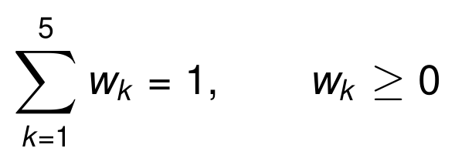
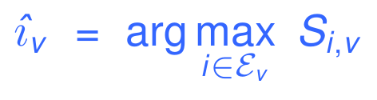
LAYER 2
One score, built from five parts
w₁ = 0.30
w₂ = 0.25
w₃ = 0.20
w₄ = 0.15
w₅ = 0.10
Recency
Family history
Travel
Workload
Continuity
Longer since the last visit scores higher
Past visits with this family, read the way the family prefers
Shorter round trip scores higher
Fewer visits this period scores higher
Small bonus for doing the previous checkpoint
Weights add to one and every part is scaled to a common range, so no single part can dominate through its units.
Pick the eligible person with the highest score. Weights live in a settings table, so the PI can retune the policy without touching code.
The Early Social Development Lab at UofSC
7
Notes:
Every one of the five parts is normalised, so no single part can dominate through units.

Slide 8
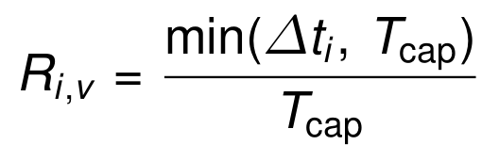
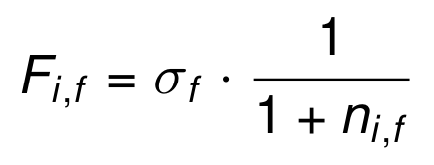
THE FIVE PARTS, ONE AND TWO
Fair rotation and family history
1
Recency
weight 0.30
2
Family history
weight 0.25
Counts days since that person's last assignment, capped at a ceiling such as 90 days.
Counts past visits with this family, then flips sign based on what the family prefers.
Someone who worked yesterday scores near zero. Someone free for three months scores one. This is what stops the same person being picked over and over.
Set the flag to plus one and a familiar person scores higher. Set it to minus one and a fresh person scores higher. The family decides, not the model.
The Early Social Development Lab at UofSC
8
Notes:
Family history is the only term that can go negative, and only when the family asks for a new face.

Slide 9
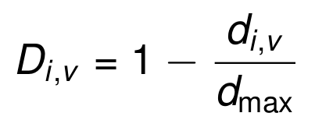
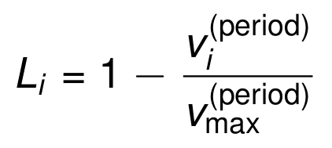
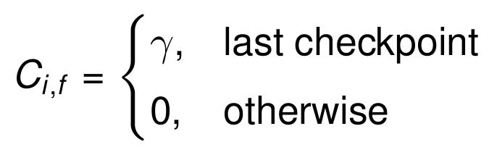
THE FIVE PARTS, THREE TO FIVE
Travel, workload, and continuity
3
Travel
4
Workload
5
Continuity
weight 0.20
weight 0.15
weight 0.10
Compares this drive to the longest drive in the eligible pool.
Compares visits done this period to the busiest person on the team.
A small fixed bonus, about 0.05, for doing the last checkpoint.
The shortest trip scores one. The longest scores zero. Everyone else sits in between.
The busiest person scores zero, so the load spreads out over a review period rather than a single week.
Deliberately small. It nudges toward a familiar face without ever overturning a fair rotation on its own.
The Early Social Development Lab at UofSC
9
Notes:
Travel and workload are both relative to the current pool, so they rescale automatically as the team changes.

Slide 10
WORKED EXAMPLE, STEP ONE
Two eligible people, side by side
What we measure | Candidate A | Candidate B | Who it favours
Days since last assignment | 5 | 20 | B
Recency score | 0.056 | 0.222 | B
Past visits with this family | 1 | 0 | A
Family history score (flag is plus one) | 0.500 | 1.000 | B
Round trip miles | 8 | 22 | A
Travel score | 0.636 | 0.000 | A
Visits already this period | 6 | 3 | B
Workload score | 0.000 | 0.500 | B
Did the previous checkpoint | Yes | No | A
Continuity bonus | 0.050 | 0.000 | A
The weights in force
Read left to right: recency, family history, travel, workload, continuity.
Split decision
A wins on travel and continuity. B wins on recency, family history, and workload. Nobody wins outright, which is exactly the case a single number is built for.
Rows in blue are the five part scores. Everything above them is the raw measurement they come from.
Illustration only, not a real assignment.
The Early Social Development Lab at UofSC
10
Notes:
Numbers here are taken straight from the architecture document, with names replaced.

Slide 11
WORKED EXAMPLE, STEP TWO
Multiply, add, compare
CANDIDATE A
CANDIDATE B
SELECTED
What this shows
Candidate B takes it by 0.118. A longer gap since the last visit, a lighter caseload, and a clean slate with this family together outweigh B's much longer drive. Continuity alone was never going to carry Candidate A, and that is the point of scoring all five parts at once instead of ranking them one after another.
The Early Social Development Lab at UofSC
11
Notes:
If the family had a strong comfort preference, that belongs in Layer 1 as a hard override, not as a bigger continuity weight.

Slide 12

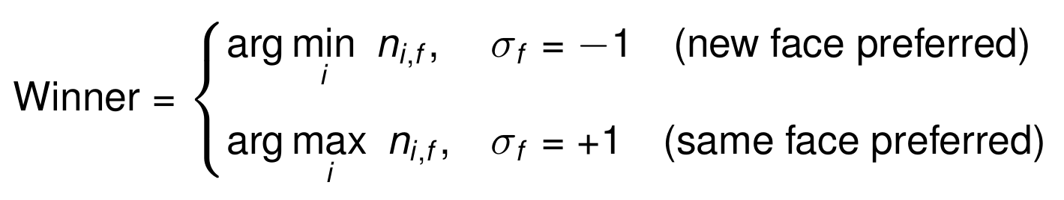
LAYER 3
What happens when two scores are almost equal
STEP ONE • DETECT
WHAT IT MEANS
If the top two scores sit inside the tolerance, the ranking is not meaningful and the model stops pretending it is.
STEP TWO • RESOLVE ON FAMILY HISTORY
Family wants a new face
Family wants the same face
Close but not tied
The person with the fewest past visits wins the tie.
The person with the most past visits wins the tie.
Still assign, but flag it so a coordinator can look before it is confirmed.
The Early Social Development Lab at UofSC
12
Notes:
The tolerance is a setting. Start it small, then widen it if coordinators keep disagreeing with close picks.

Slide 13
SAFETY STOPS
When a person decides instead of the score
Does the family have a dual relationship flag?
Remove that person from the pool. No score is computed for them at all.
YES
Is there a PI hold on the family record?
Pause the automatic pick and route the visit to the PI for a manual decision.
YES
Neither flag is set
Score the eligible pool, pick the top person, and confirm automatically.
GO
These checks run before scoring, never after. A family concern is a stop sign, not a penalty term.
The Early Social Development Lab at UofSC
13
Notes:
This mirrors the real case where a relationship concern required explicit human sign off before the visit was finalised.

Slide 14
WHAT IT NEEDS TO RUN
Eight tables feed the whole model
Table | Key fields | Feeds
availability | candidate id, date start, date end | Layer 1 open slot check
family exclusions | family id, excluded candidate id, reason | Layer 1 conflict check
certifications | candidate id, visit type, certified | Layer 1 credential check
visit history | visit id, family id, candidate id, date, visit type | Recency, family history, continuity
distance matrix | candidate id, family id, distance miles | Travel score
workload period | candidate id, period, visit count | Workload score
family continuity flag | family id, sigma, preferred candidate id | Family preference and overrides
scoring weights | w1 to w5, effective date | Versioned policy settings
Only the last two tables are new policy. The first six are records the lab already keeps, which is why this can be built without changing how anyone works day to day.
The Early Social Development Lab at UofSC
14
Notes:
Weights are versioned by effective date so a past assignment can always be reproduced with the weights in force at the time.

Slide 15

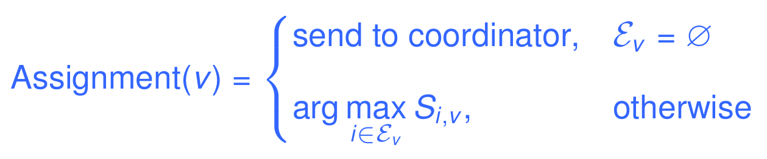

THE WHOLE RULE, IN ONE LINE
No feasible pool, no assignment.
No assignment without a score you can read.
Explainable
Tunable
Honest
Every pick reduces to five numbers and five weights that anyone can check by hand.
The PI changes the weights in a settings table. No code release, and old picks stay reproducible.
Close calls and family concerns come back to a person, by design rather than by accident.
Notes:
Next step: confirm the starting weights and the tie tolerance with the PI, then wire the two new tables.

